Slide 1
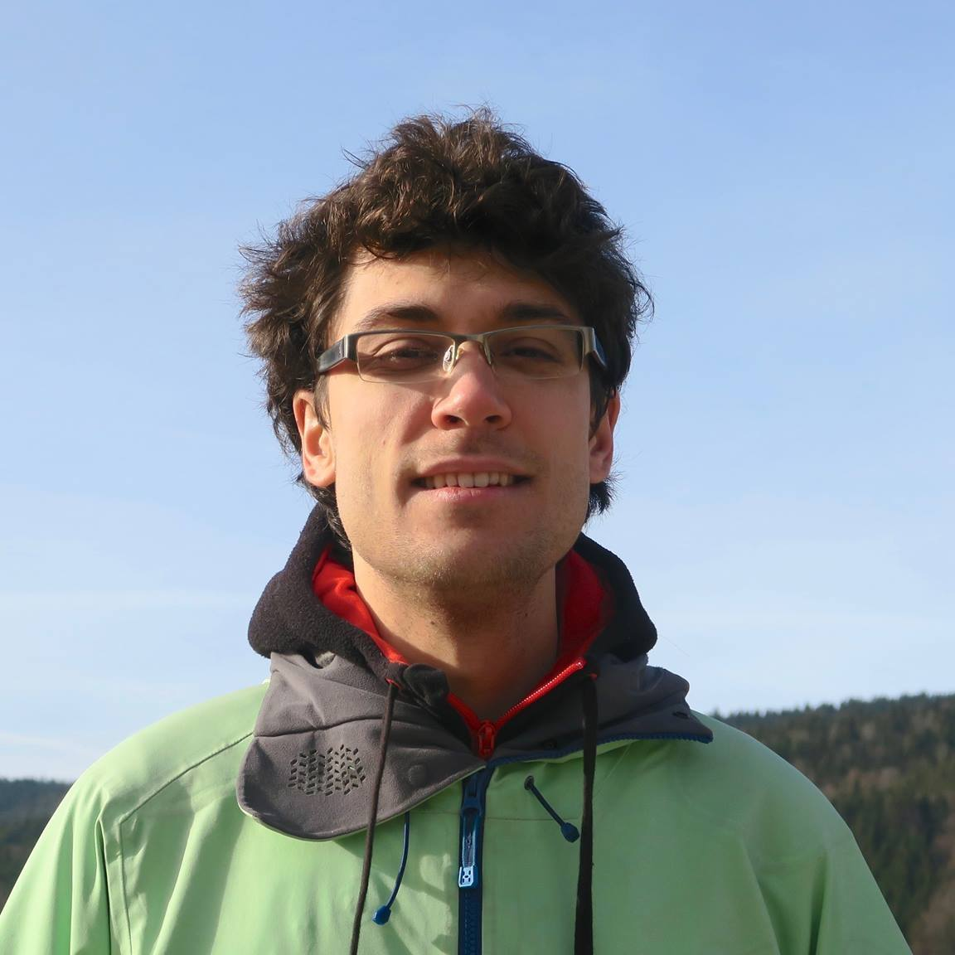


Streaming Euclidean $k$-median and $k$-means with $o(\log{n)}$ Space
Vincent Cohen-Addad
David P. Woodruff
Samson Zhou

Slide 2
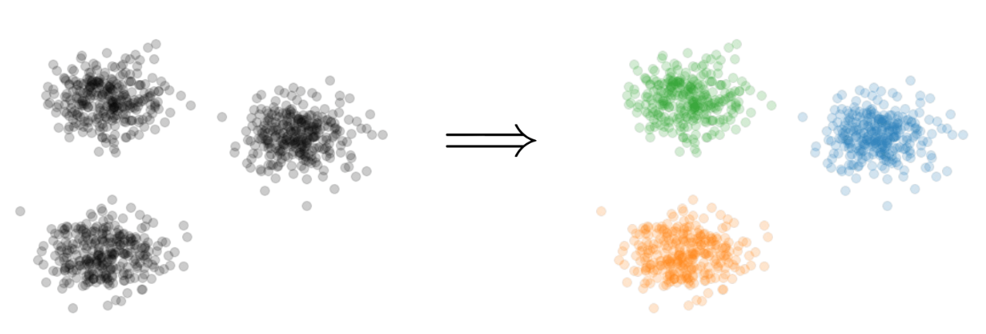

$k$-Clustering
Goal: Given input dataset $X$, find a set $C$ of $k$ centers that implicitly partition $X$ into at most $k$different clusters, while minimizing some associated cost function of the clustering
$$k=3$$

Slide 3
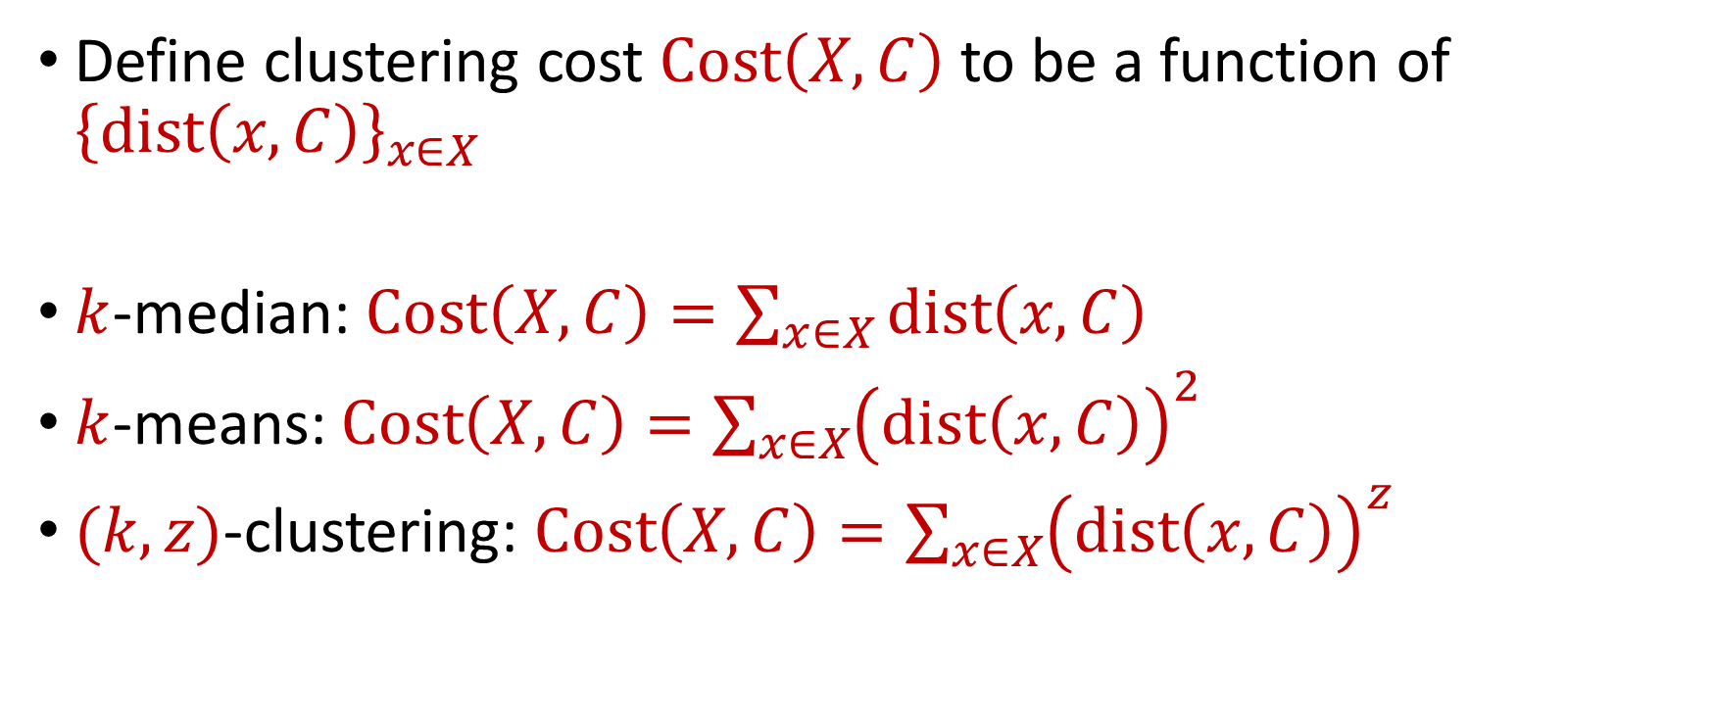
$k$-Clustering
Define clustering cost $Cost\left(X,C\right)$ to be a function of ${\left\{dist\left(x,C\right)\right\}}_{x∈X}$
$k$-median: $Cost\left(X,C\right)=\sum_{x∈X}{dist\left(x,C\right)}$
$k$-means: $Cost\left(X,C\right)=\sum_{x∈X}{{\left(dist\left(x,C\right)\right)}^{2}}$
$(k,z)$-clustering: $Cost\left(X,C\right)=\sum_{x∈X}{{\left(dist\left(x,C\right)\right)}^{z}}$
$${\left(⋅\right)}^{z}$$
$${\left(⋅\right)}^{z}$$
$${\left(⋅\right)}^{z}$$
$${\left(⋅\right)}^{z}$$
$${\left(⋅\right)}^{z}$$
$${\left(⋅\right)}^{z}$$
$${\left(⋅\right)}^{z}$$

Slide 4
Euclidean $k$-Clustering
For Euclidean $k$-clustering, input points $X=x_{1},…,x_{n}$ are in $ℝ^{d}$ (for us, they will be in ${[Δ]}^{d}≔{\left\{1,2,…,Δ\right\}}^{d}$)
$dist\left(x,y\right)=\sqrt{{\left(x_{1}−y_{1}\right)}^{2}+…+{\left(x_{d}−y_{d}\right)}^{2}}$ is the Euclidean distance
$(k,z)$-clustering problem:
$$\min_{C:\left|C\right|≤k} Cost\left(X,C\right)=\min_{C:\left|C\right|≤k}{Σ_{x∈X}\left(dist\left(x,C\right)\right)}^{z}$$

Slide 5
The Streaming Model
Input: Updates to an underlying data set $X$ that arrive sequentially
Output: Evaluation (or approximation) of a given function
Goal: Use space sublinear in the size $n$of the input $X$

Slide 6
Goal: Cluster a stream of $n$ points using $o(\log{n)}$ space

Slide 7
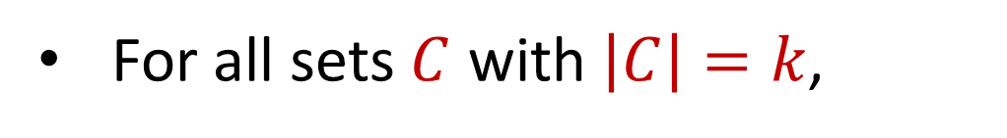
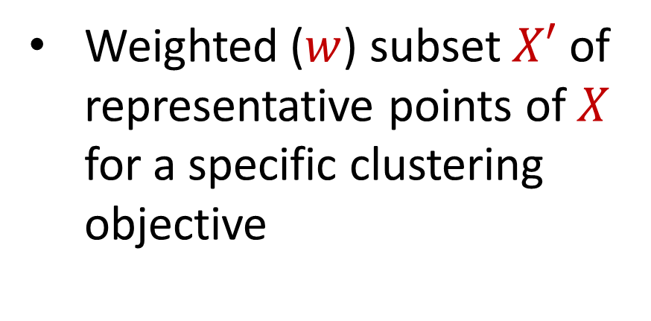
Coreset
Weighted ($w$) subset $X′$ of representative points of $X$ for a specific clustering objective
For all sets $C$ with $\left|C\right|=k$,
$$\left(1−ε\right)Cost(X,C)≤Cost(X′,C,w)≤\left(1+ε\right)Cost(X,C)$$

Slide 8
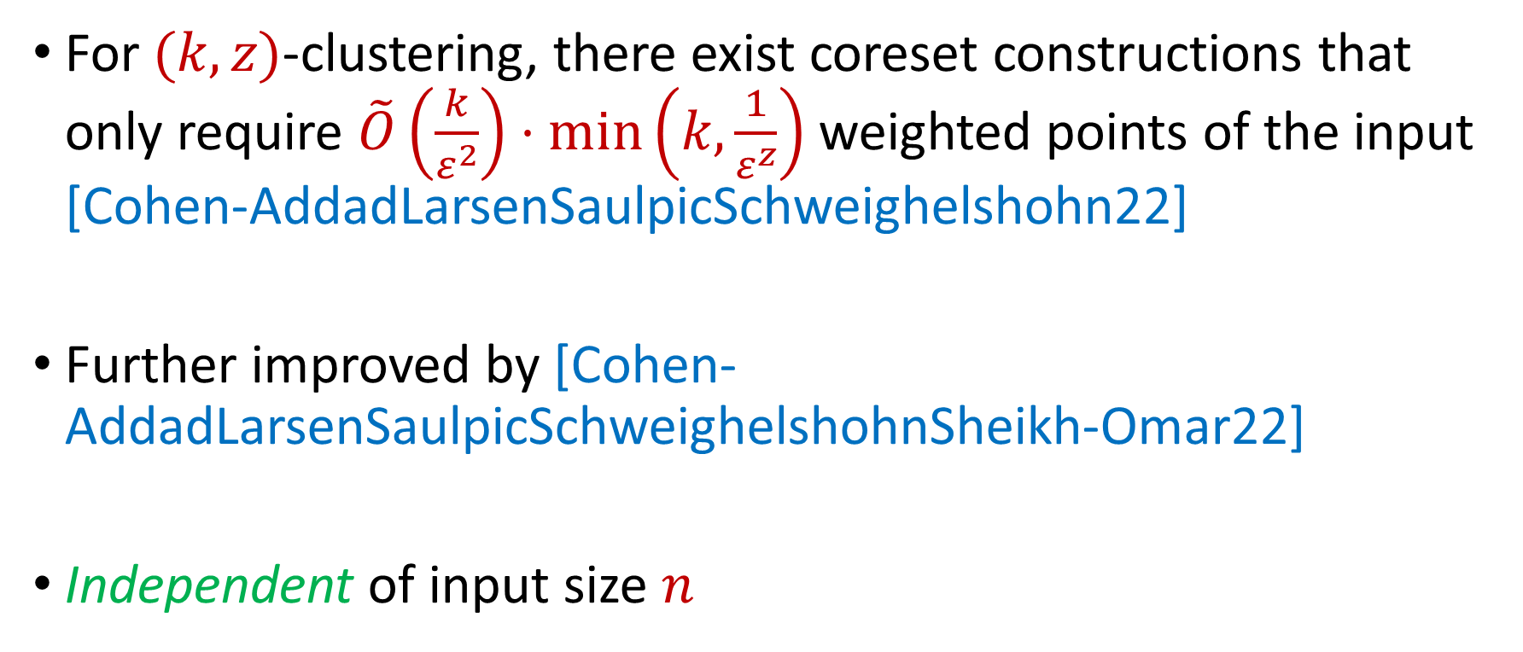
Coreset Constructions
For $(k,z)$-clustering, there exist coreset constructions that only require $\tilde{O}\left(\frac{k}{ε^{2}}\right)⋅\min\left(k,\frac{1}{ε^{z}}\right)$ weighted points of the input [Cohen-AddadLarsenSaulpicSchweighelshohn22]
Further improved by [Cohen-AddadLarsenSaulpicSchweighelshohnSheikh-Omar22]
Independent of input size $n$

Slide 9

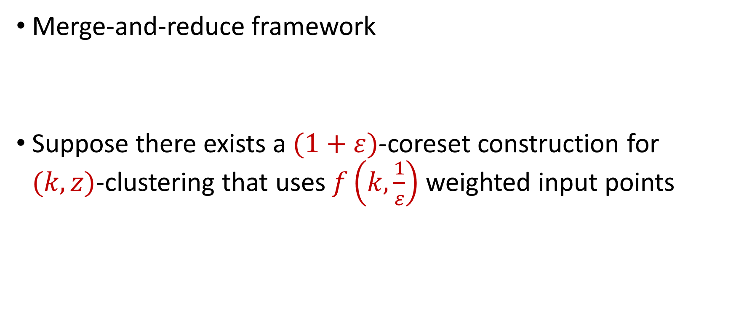
$(k,z)$-Clustering in the Streaming Model
Merge-and-reduce framework
Suppose there exists a $(1+ε)$-coreset construction for $(k,z)$-clustering that uses $f\left(k,\frac{1}{ε}\right)$ weighted input points
$$\tilde{O}\left(\frac{k}{ε^{2+z}}\right)$$

Slide 10
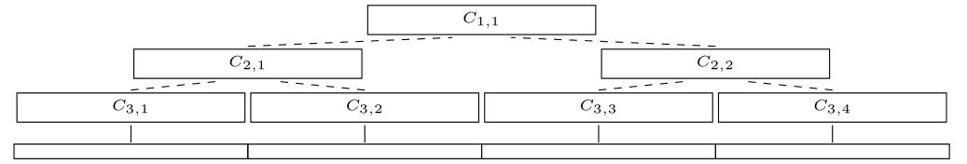

$(k,z)$-Clustering in the Streaming Model
Partition the stream into blocks containing $f\left(k,\frac{\log{n}}{ε}\right)$ points
Create a $\left(1+\frac{ε}{\log{n}}\right)$-coreset for each block
Create a $\left(1+\frac{ε}{\log{n}}\right)$-coreset for the set of points formed by the union of two coresets for each block
$$\tilde{O}\left(\frac{k}{ε^{2+z}}\log^{2}{n}\right)$$
Merge
Reduce

Slide 11
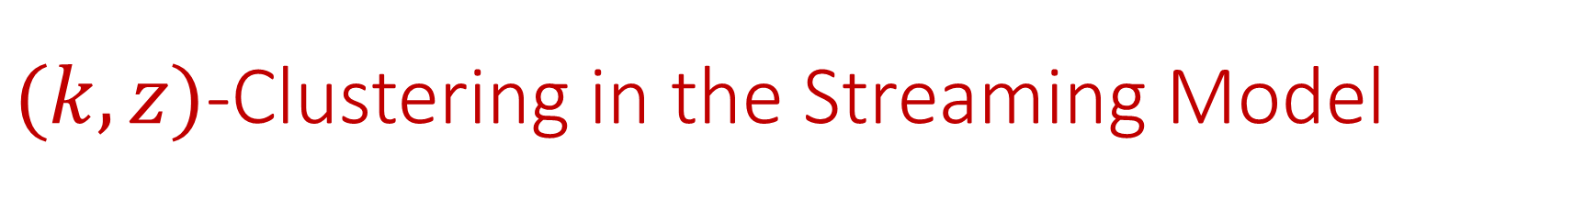
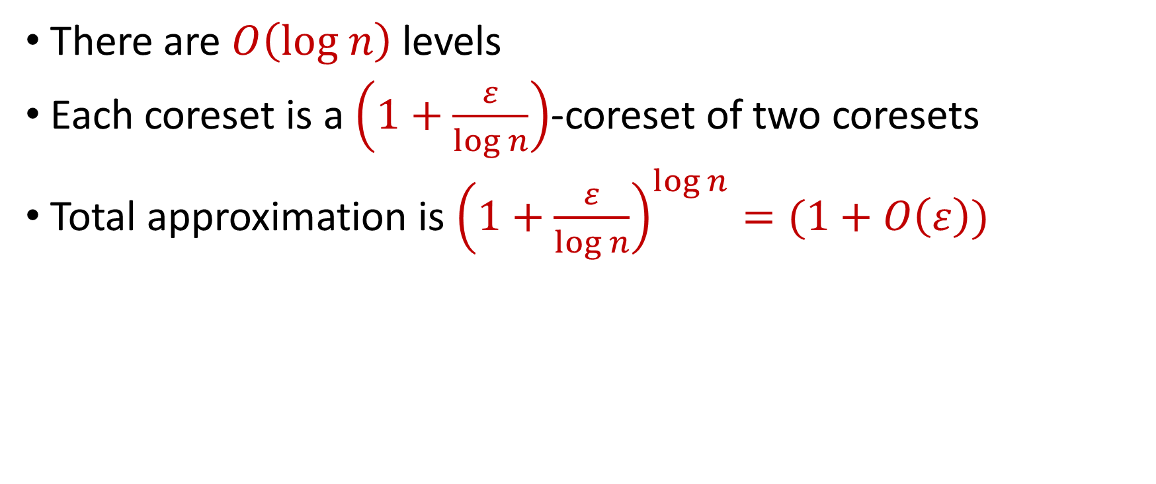
$(k,z)$-Clustering in the Streaming Model
There are $O\left(log n\right)$ levels
Each coreset is a $\left(1+\frac{ε}{\log{n}}\right)$-coreset of two coresets
Total approximation is ${\left(1+\frac{ε}{\log{n}}\right)}^{\log{n}}=(1+O\left(ε\right))$

Slide 12

$(k,z)$-Clustering in the Streaming Model
Total space is $f\left(k,\frac{\log{n}}{ε}\right)⋅O(log{n)}$ points
For $k$-means clustering, this is $\tilde{O}\left(\frac{k}{ε^{4}}⋅\log^{3}{n}\right)$ points

Slide 13
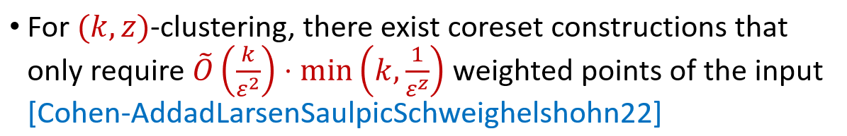
$(k,z)$-Clustering in the Streaming Model
Total space is $f\left(k,\frac{\log{n}}{ε}\right)⋅O(log{n)}$ points
For $k$-means clustering, this is $\tilde{O}\left(\frac{k}{ε^{4}}⋅\log^{3}{n}\right)$ points

Slide 14
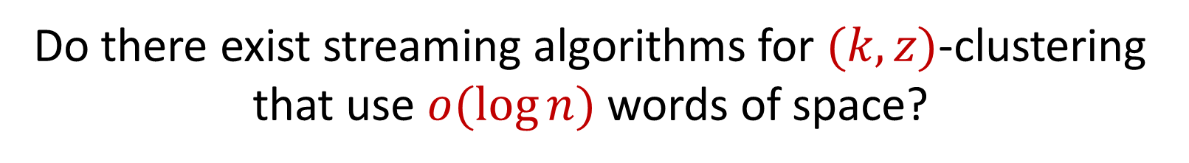
$(k,z)$-Clustering in the Streaming Model
Total space is $f\left(k,\frac{\log{n}}{ε}\right)⋅O(log{n)}$ points
For $k$-means clustering, this is $\tilde{O}\left(\frac{k}{ε^{4}}⋅\log^{3}{n}\right)$ points
Do there exist streaming algorithms for $(k,z)$-clustering that use $o(\log{n)}$ words of space?

Slide 15
Our Results (Insertion-Only)
There exists a one-pass algorithm on insertion-only streams that outputs $(1+ε)$-approximation for $(k,z)$-clustering for all times in the stream and uses $\tilde{O}\left(\frac{dk}{ε^{2}}\right)⋅\min\left(k,\frac{1}{ε^{z}}\right)⋅poly(\log{\log{nΔ)}}$ words of space
Our algorithm outputs $(1+ε)$-coreset constructions for $(k,z)$-clustering for all times in the stream

Slide 16
Our Results (Insertion-Deletion Impossibility)
Any one-pass algorithm on insertion-deletion streams that outputs a $2$-approximation to the $(k,z)$-clustering cost at all times in the stream with $d=Ω\left(\log{n}\right)$ must use $Ω\left(\log^{2}{n}\right)$ bits of space
Any one-pass algorithm on insertion-deletion streams that outputs a $2$-approximation to the $(k,z)$-clustering cost from a weighted subset of the input must use $Ω\left(\log^{2}{n}\right)$ bits of space

Slide 17
Our Results (Insertion-Deletion Two-Pass)
There exists a two-pass algorithm on insertion-deletion streams that outputs a $(1+ε)$-coreset construction for $k$-median and $k$-means clustering that uses $\tilde{O}\left(\frac{1}{ε^{2}}\right)⋅poly\left(d,k,\log{\log{nΔ}}\right)$ words of space
Result generalizes to $z∈[1,2]$

Slide 18
Our Results (Sum of the Online Sensitivities)
Sum of the online sensitivities of a set of $n$ points in $ℝ^{d}$ for $(k,z)$-clustering is at most $O\left(k\log^{2}{(ndΔ)}\right)$

Slide 19
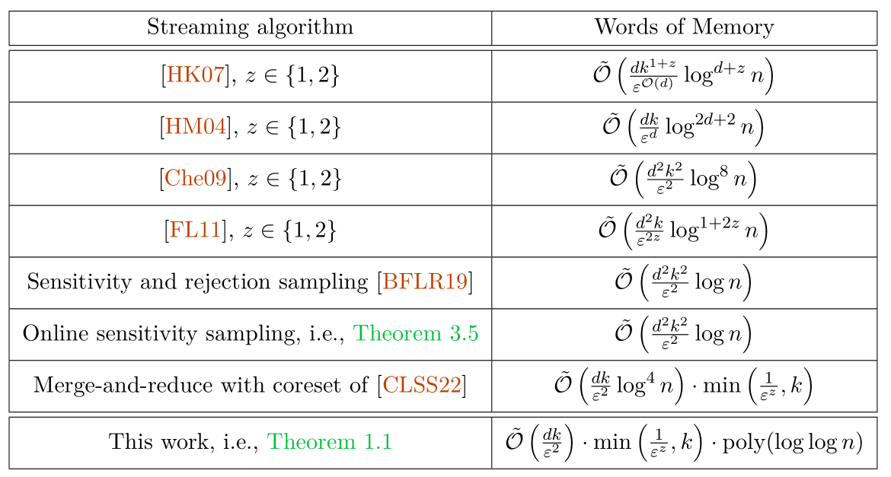

Slide 20
Insertion-Only Streams

Slide 21
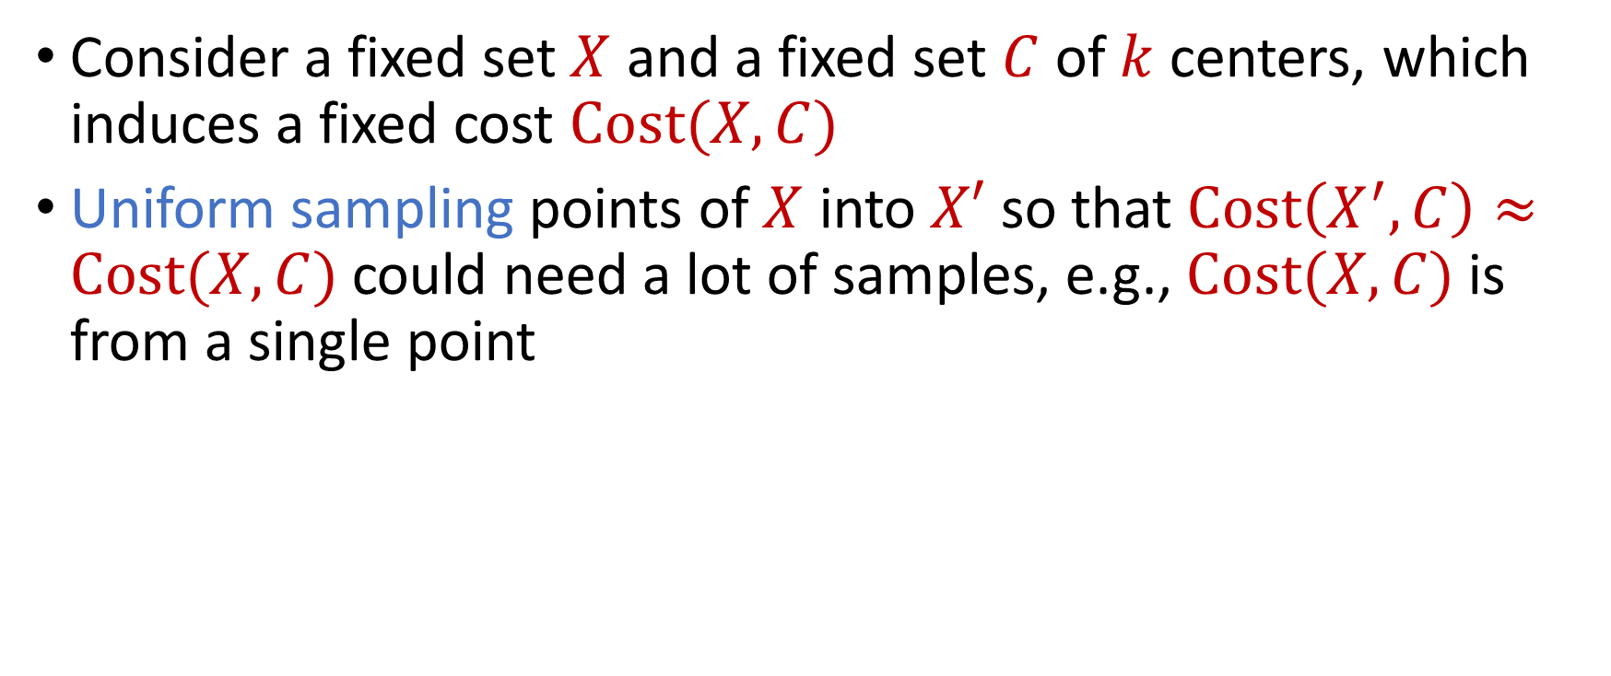
Coreset Construction and Sampling
Consider a fixed set $X$ and a fixed set $C$ of $k$ centers, which induces a fixed cost $Cost(X,C)$
Uniform sampling points of $X$ into $X′$ so that $Cost\left(X^{′},C\right)≈Cost(X,C)$could need a lot of samples, e.g., $Cost(X,C)$is from a single point

Slide 22
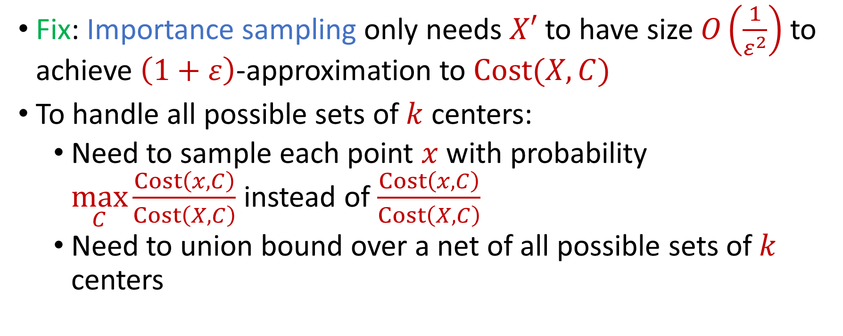
Coreset Construction and Sampling
Fix: Importance sampling only needs $X′$ to have size $O\left(\frac{1}{ε^{2}}\right)$ to achieve $\left(1+ε\right)$-approximation to $Cost(X,C)$
To handle all possible sets of $k$ centers:
Need to sample each point $x$ with probability $\max_{C}\frac{Cost\left(x,C\right)}{Cost\left(X,C\right)}$ instead of $\frac{Cost\left(x,C\right)}{Cost\left(X,C\right)}$
Need to union bound over a net of all possible sets of $k$ centers
Net with size ${\left(\frac{nΔ}{ε}\right)}^{O(kd)}$

Slide 23
Sensitivity Sampling
The quantity $s\left(x\right)=\max_{C}\frac{Cost\left(x,C\right)}{Cost\left(X,C\right)}$ is called the sensitivity of $x$ and intuitively measures how “important” the point $x$ is
The total sensitivity of $X$ is $\sum_{x∈X}{s(x)}$ and quantifies how many points will be sampled into $X′$ through importance/sensitivity sampling (before the union bound)

Slide 24
Online Sensitivity
In a data stream, computing/approximating sensitivity $s\left(x\right)=\max_{C}\frac{Cost\left(x,C\right)}{Cost\left(X,C\right)}$ requires seeing the entire dataset $X$, but then it is too late to sample $x$
We define the online sensitivity of $x_{t}$ with respect to a stream $x_{1},…,x_{n}$ to be $φ\left(x_{t}\right)=\max_{C}\frac{Cost\left(x_{t},C\right)}{Cost\left(X_{t},C\right)}$, where $X_{t}=x_{1},…,x_{t}$, which intuitively measures how “important” the point $x$ is SO FAR

Slide 25
Online Sensitivity
Streaming algorithm: sample each point $x_{t}$ with probability $p\left(x_{t}\right)=\min\left(1,\frac{kd}{ε^{2}}⋅polylog\left(nΔ\right)⋅φ(x_{t})\right)$
How to compute (or approximate) $φ(x_{t})$?

Slide 26
Online Sensitivity
Observation: we can use a $\left(1+ε\right)$-coreset to obtain a $\left(1+ε\right)$-approximation to $φ\left(x_{t}\right)$
Use samples obtained from online sensitivity sampling at each time $t−1$ to obtain a $\left(1+ε\right)$-approximation to $φ\left(x_{t}\right)$
Can then perform online sensitivity sampling at time $t$ and by induction, at all times in the stream

Slide 27
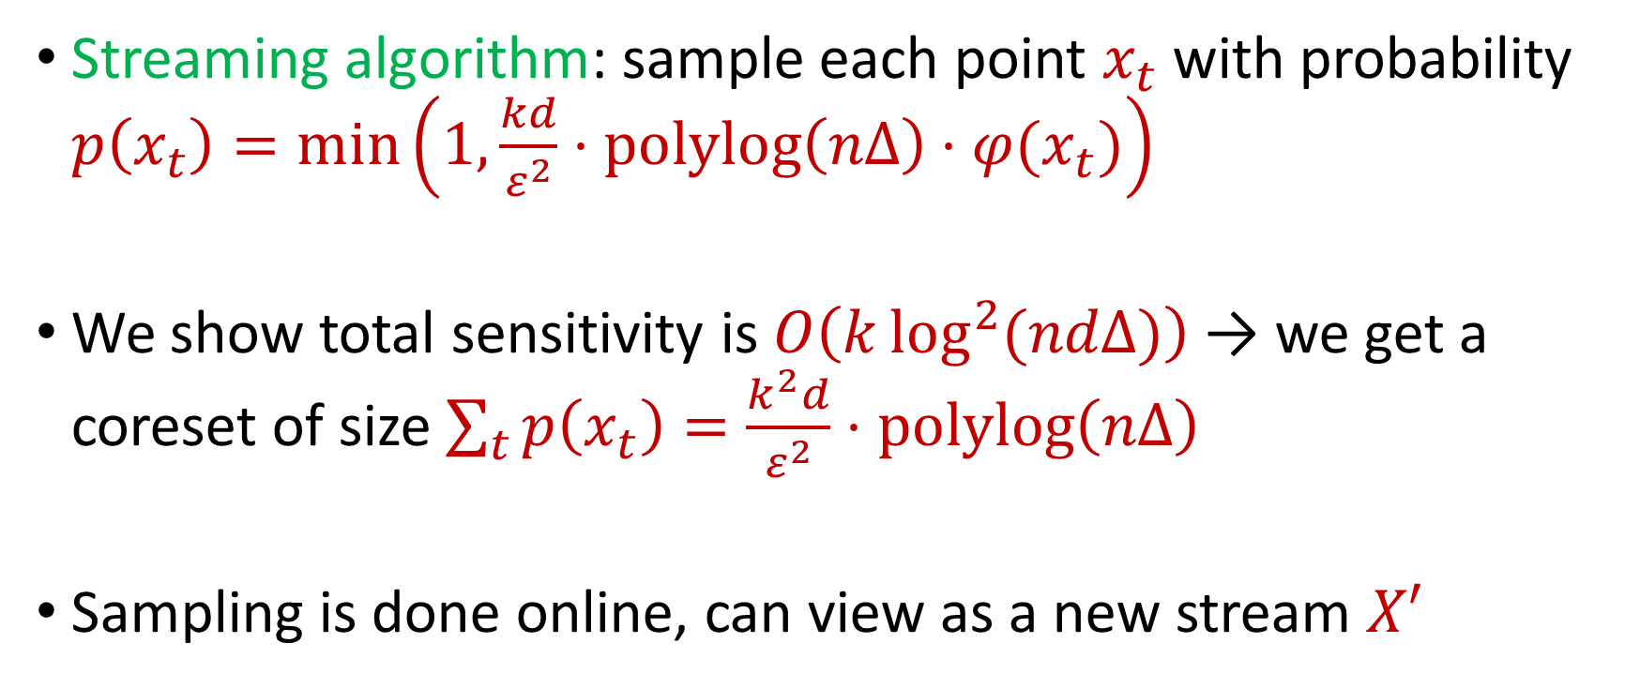
Online Sensitivity
Streaming algorithm: sample each point $x_{t}$ with probability $p\left(x_{t}\right)=\min\left(1,\frac{kd}{ε^{2}}⋅polylog\left(nΔ\right)⋅φ(x_{t})\right)$
We show total sensitivity is $O\left(k\log^{2}{(ndΔ)}\right)$ → we get a coreset of size $\sum_{t}{p\left(x_{t}\right)}=\frac{k^{2}d}{ε^{2}}⋅polylog\left(nΔ\right)$
Sampling is done online, can view as a new stream $X′$

Slide 28
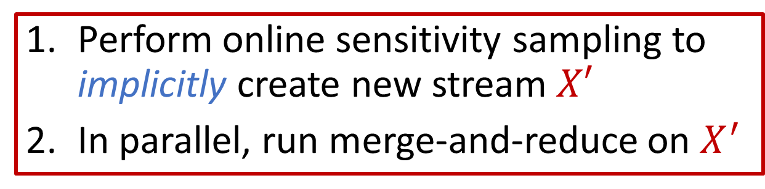
Insertion-Only Algorithm
Perform online sensitivity sampling to implicitly create new stream $X′$
In parallel, run merge-and-reduce on $X^{′}$

Slide 29
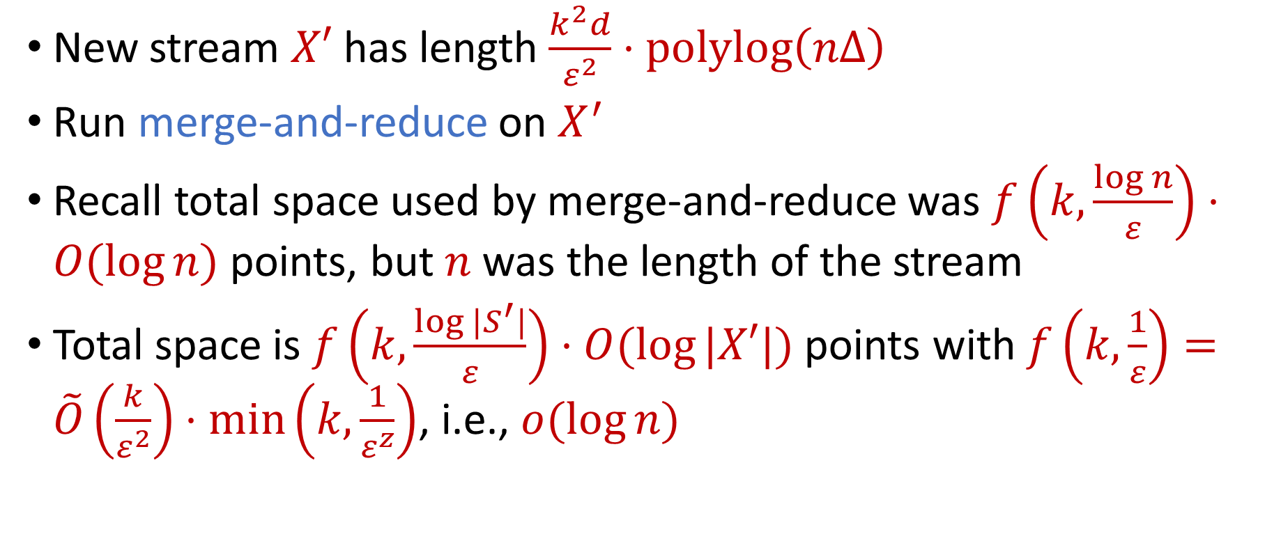
Insertion-Only Summary
New stream $X′$ has length $\frac{k^{2}d}{ε^{2}}⋅polylog\left(nΔ\right)$
Run merge-and-reduce on $X^{′}$
Recall total space used by merge-and-reduce was $f\left(k,\frac{\log{n}}{ε}\right)⋅O(log{n)}$ points, but $n$ was the length of the stream
Total space is $f\left(k,\frac{\log{|S^{′}|}}{ε}\right)⋅O(log{|X′|)}$ points with $f\left(k,\frac{1}{ε}\right)=\tilde{O}\left(\frac{k}{ε^{2}}\right)⋅\min\left(k,\frac{1}{ε^{z}}\right)$, i.e., $o(\log{n)}$

Slide 30
Insertion-Deletion Streams

Slide 31
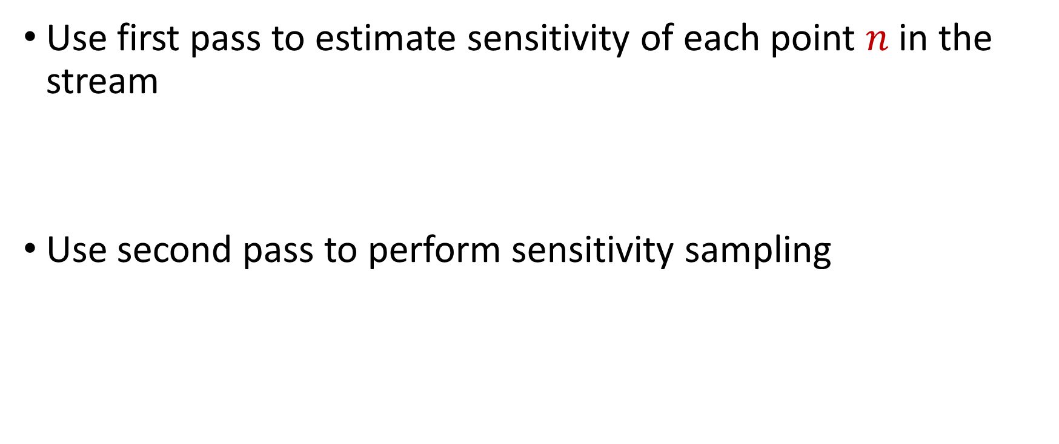
Insertion-Deletion Streams
Use first pass to estimate sensitivity of each point $n$ in the stream
Use second pass to perform sensitivity sampling

Slide 32
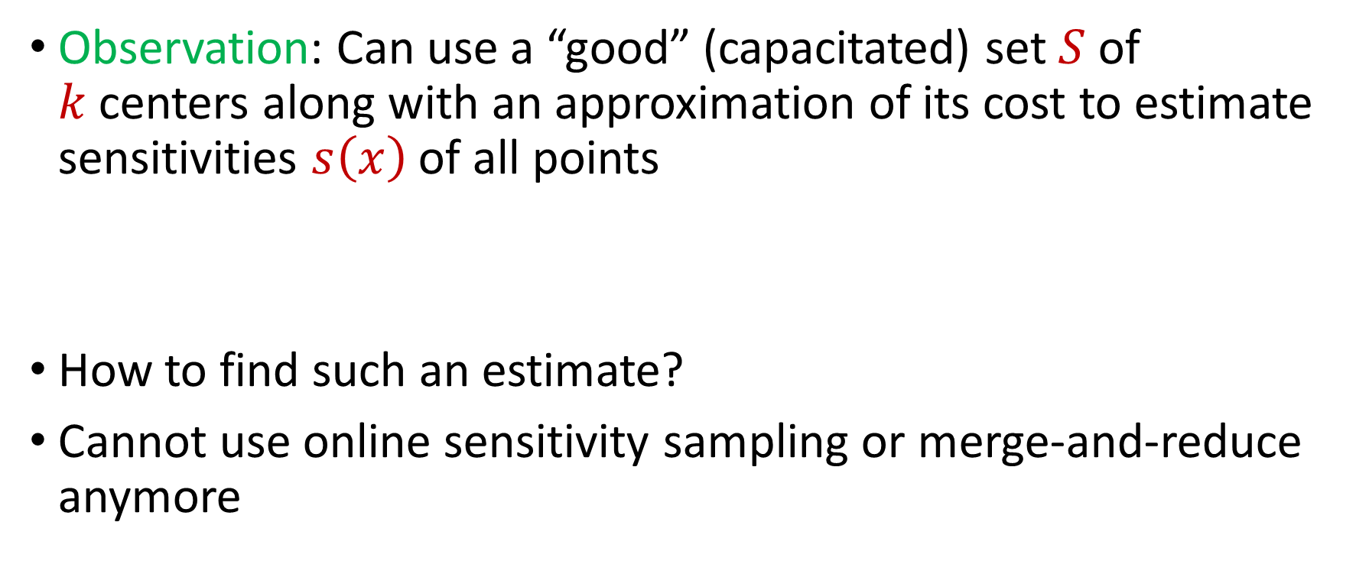
Sensitivity Estimation
Observation: Can use a “good” (capacitated) set $S$ of $k$centers along with an approximation of its cost to estimate sensitivities $s\left(x\right)$ of all points
How to find such an estimate?
Cannot use online sensitivity sampling or merge-and-reduce anymore

Slide 33
Quadtree Embedding

Slide 34
Quadtree Embedding
$$Δ$$

Slide 35
Quadtree Embedding
$$Δ$$

Slide 36
Quadtree Embedding
$$Δ$$

Slide 37
Quadtree Embedding
Total cost: $0$
Level cost: $0$
7
$$Δ$$
6
6

Slide 38
Quadtree Embedding
Total cost: $\frac{Δ}{2}⋅7$
Level cost: $\frac{Δ}{2}⋅7$
7
$$Δ$$
6
6

Slide 39
Quadtree Embedding
Total cost: $\left(\frac{7}{2}+\frac{11}{4}\right)Δ$
Level cost: $\frac{Δ}{4}⋅11$
7
$$Δ$$
6
6

Slide 40
EMD Sketch Summary
EMD sketch: There exists a one-pass streaming algorithm that uses $O\left(kd^{2}\log{Δ}\left(\log{\log{Δ}}\right)\right)$ bits of space and outputs $Z$ (as well as the capacitated set of centers) such that
Recall: Can use a “good” (capacitated) set $S$ of $k$centers along with an approximation of its cost to estimate sensitivities $s\left(x\right)$ of all points
$$OPT≤O\left(\sqrt{d}\right)⋅Z≤⋅O\left(d^{1.5}\right)(\log{k+\log{\log{Δ)}}}OPT$$

Slide 41
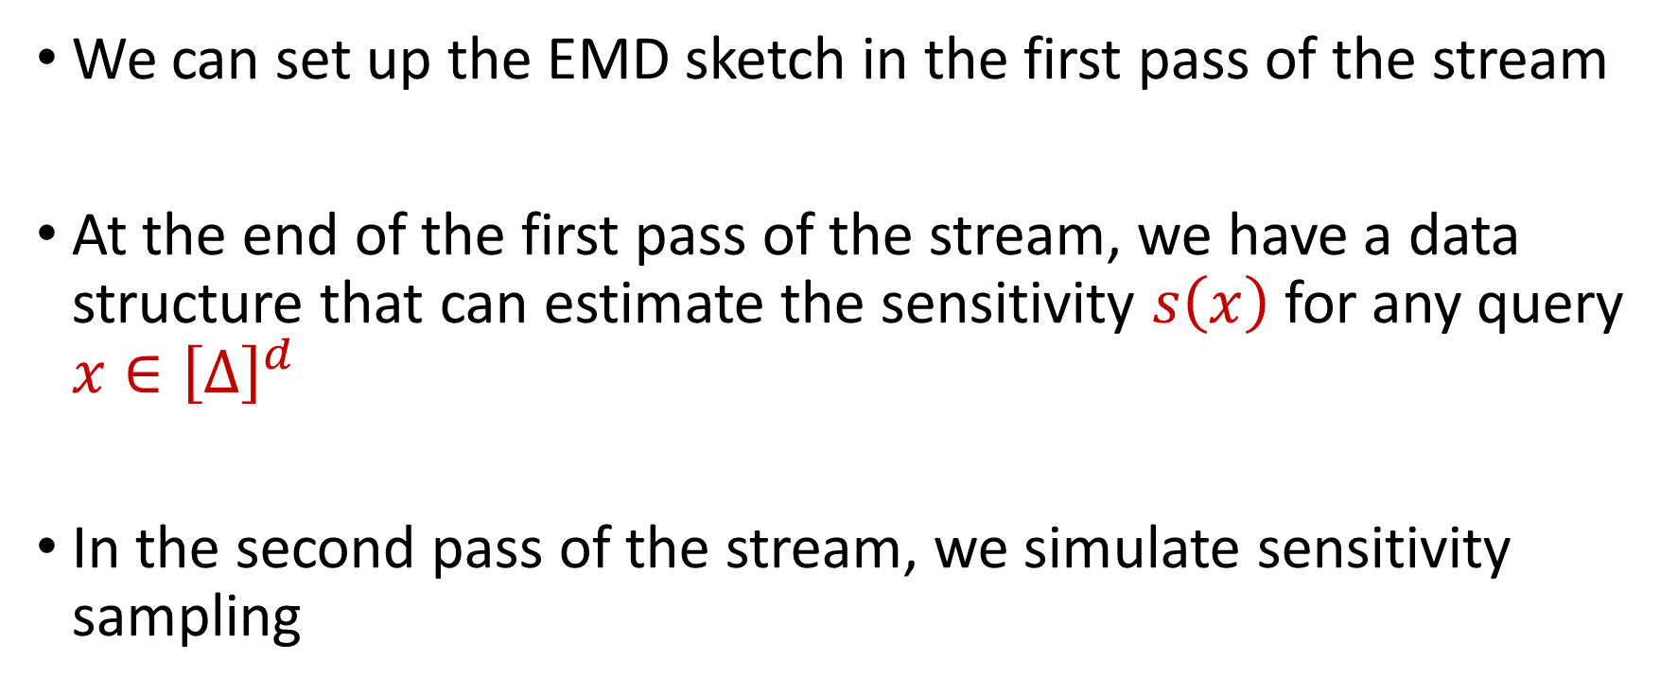
First Pass to Second Pass
We can set up the EMD sketch in the first pass of the stream
At the end of the first pass of the stream, we have a data structure that can estimate the sensitivity $s\left(x\right)$ for any query $x∈{\left[Δ\right]}^{d}$
In the second pass of the stream, we simulate sensitivity sampling

Slide 42
$k$-Median Framework
First pass: set up the EMD sketch
Second pass:
Sample elements into a substream $U′$ with probability proportional to their sensitivities
Run sparse recovery on $U′$

Slide 43
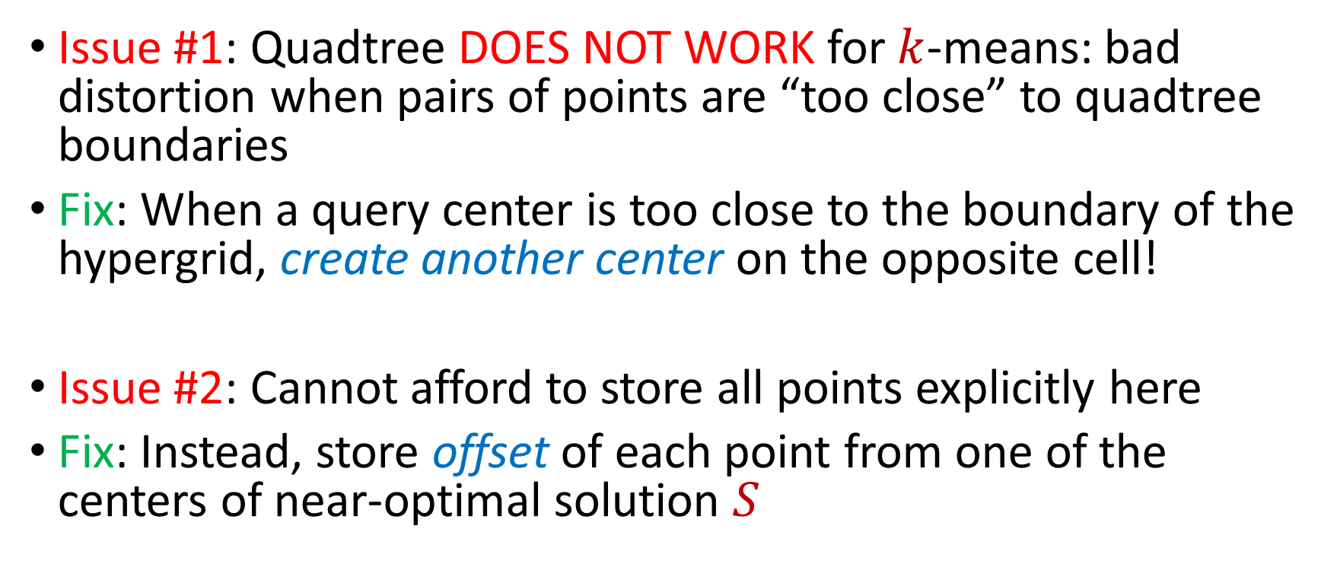
Applying $k$-Median Framework to $k$-Means
Issue #1: Quadtree DOES NOT WORK for $k$-means: bad distortion when pairs of points are “too close” to quadtree boundaries
Fix: When a query center is too close to the boundary of the hypergrid, create another center on the opposite cell!
Issue #2: Cannot afford to store all points explicitly here
Fix: Instead, store offset of each point from one of the centers of near-optimal solution $S$

Slide 44
$k$-Means Framework
First pass: set up the Wasserstein-$z$ sketch
Second pass:
Sample offsets of elements into a substream $U′$ with probability proportional to their sensitivities
Run sparse recovery on $U′$

Slide 45
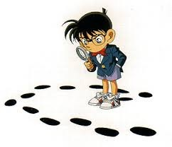

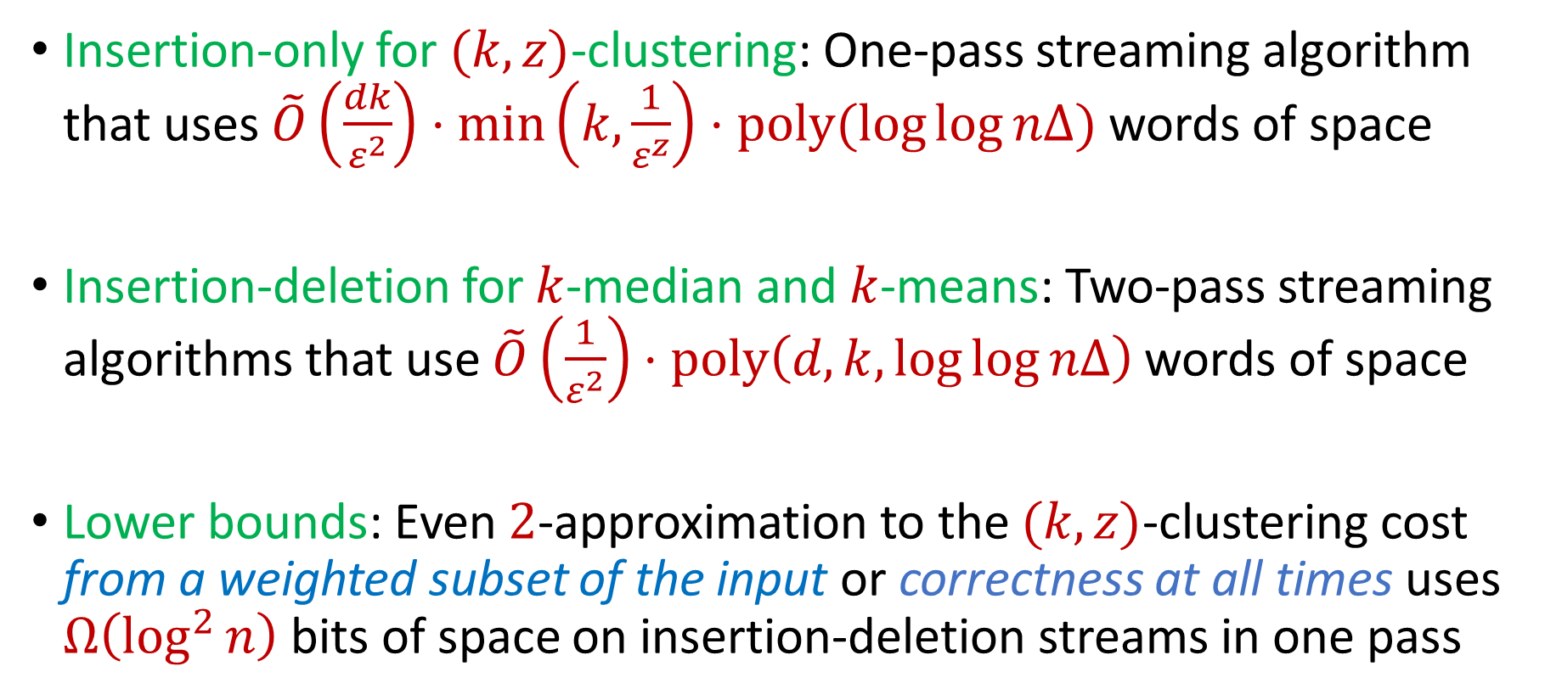
Summary
Insertion-only for $(k,z)$-clustering: One-pass streaming algorithm that uses $\tilde{O}\left(\frac{dk}{ε^{2}}\right)⋅\min\left(k,\frac{1}{ε^{z}}\right)⋅poly(\log{\log{nΔ)}}$ words of space
Insertion-deletion for $k$-median and $k$-means: Two-pass streaming algorithms that use $\tilde{O}\left(\frac{1}{ε^{2}}\right)⋅poly\left(d,k,\log{\log{nΔ}}\right)$ words of space
Lower bounds: Even $2$-approximation to the $(k,z)$-clustering cost from a weighted subset of the input or correctness at all times uses $Ω\left(\log^{2}{n}\right)$ bits of space on insertion-deletion streams in one pass

Slide 46
Quadtree Embedding
Intuition: Bad distortion results when pairs of points are “too close” to the boundary of the hypergrid
Goal: Prevent this case from happening
Fix: When a query center is too close to the boundary of the hypergrid, create another center on the opposite cell!

Slide 47
Quadtree Embedding
7
$$Δ$$
6
6

Slide 48
Quadtree Embedding
7
$$Δ$$
6
6

Slide 49
Quadtree Embedding
If $x$ and $c$ have distance $αΔ$, the probability it will be split by a grid of length $\frac{Δ}{2^{i}}$ is roughly $\frac{2^{i}}{α}$
Expected cost for $k$-median is $αΔ$
Expected cost of $k$-means is $\frac{Δ^{2}}{2^{i}α}$, i.e., distortion $2^{i}α^{3}$
Recall: worse EMD sketch guarantee corresponds to larger oversampling necessary for sensitivity sampling

Slide 50
Quadtree Embedding
Make a new center when distance from query center and hypergrid with length $2^{i}$ is at most $\frac{2^{i}}{d\log{Δ}}$
In expectation (over $d$ dimensions, $\log{Δ}$ levels of the hypergrid, and $k$ query centers), $O(k)$ new centers are created

Slide 51
Wasserstein Sketch
Wasserstein-$z$ distance: $WASSD\left(C,X\right)$ denotes the $(k,z)$-clustering cost $Cost\left(C,X\right)$for $X$ a (capacitated) set $C$ of centers
Wasserstein sketch: There exists a one-pass streaming algorithm that uses $O\left(d\log{Δ}\right)$ bits of space and outputs $Z$ such that
$$Z≤⋅O\left(d^{1+0.5z}\log^{z−1}{Δ}\right)⋅WASSD(C,X)$$

Slide 52
Applying $k$-Median Framework to $k$-Means
First pass: set up the Wasserstein sketch
Second pass:
Sample elements into a substream $U′$ with probability proportional to their sensitivities
Run sparse recovery on $U′$

Slide 53
Applying $k$-Median Framework to $k$-Means
Problem: Because the distortion of the Wasserstein embedding is $O\left(d^{1+0.5z}\log^{z−1}{Δ}\right)$, we need to sample $O\left(d^{2}\log{Δ}\right)$ points for $k$-means
For $k$-median, we stored all the points, using $O\left(d\log{Δ}\right)$ bits of space per point
Cannot afford to store all points explicitly here

Slide 54
Applying $k$-Median Framework to $k$-Means
Cannot afford to store all points explicitly here
Instead, store offset of each point from one of the centers of near-optimal solution $S$
For each point $x$, let $c_{x}$ be the closest center of $S$ and $y=c_{x}−x$
Round $y$ coordinate-wise to nearest power of $1+poly\left(\frac{ε}{log ndΔ}\right)$ and store the vector of exponents $\tilde{y}$

Slide 55
Quadtree Embedding
$$x$$
$$c_{x}$$
$$Δ$$

Slide 56
Quadtree Embedding
$$x$$
$$y=c_{x}−x$$
$$c_{x}$$
$$Δ$$

Slide 57
Quadtree Embedding
$$x$$
$$\tilde{y}$$
$$c_{x}$$
$$Δ$$

Slide 58
$k$-Means Framework
First pass: set up the Wasserstein-$z$ sketch
Second pass:
Sample offsets of elements into a substream $U′$ with probability proportional to their sensitivities
Run sparse recovery on $U′$

Slide 59
$k$-Means Framework
We show the resulting samples forms a semi-coreset
Sample $O\left(d^{2}\log{Δ}\right)$ points, each point using $d⋅O\left(\log{\frac{1}{ε}+\log{\log{ndΔ}}}\right)$
Total space: $\tilde{O}\left(\frac{1}{ε^{2}}\right)⋅poly\left(d,k,\log{\log{nΔ}}\right)$ words

Slide 60
Quadtree Embedding
Earth mover distance: $EMD\left(C,X\right)$ denotes the $k$-median clustering cost $Cost\left(C,X\right)$for $X$ using a (capacitated) set $C$ of centers
Quadtree embedding: For a (weighted) set $C$ of centers, the quadtree embedding outputs $Z$ such that
$$EMD\left(C,X\right)≤O\left(\sqrt{d}\right)⋅Z≤⋅O\left(d^{1.5}\right)(\log{k+\log{\log{Δ)}}}EMD(C,X)$$

Slide 61
Quadtree Embedding
Quadtree embedding produces a vector of dimension $Δ^{O(d)}$
The computation of $Z$ is the sum of the level costs, which is the $L_{1}$ norm of the frequency vector
There exists a one-pass streaming algorithm that outputs a constant-factor approximation to the $L_{1}$ norm of a frequency vector in $ℝ^{n}$ and uses $O\left(\log{n}\right)$ bits of space [Indyk06]

Slide 62
$L_{1}$ Norm Approximation
There exists a one-pass streaming algorithm that outputs a constant-factor approximation to the $L_{1}$ norm of an underlying vector $x$ in $ℝ^{n}$ and uses $O\left(\log{n}\right)$ bits of space [Indyk06]
Generate vector $v_{1},…v_{α}∈ℝ^{n}$ of Cauchy random variables (ratio of two normal random variables) for $α=O(1)$
Output ${median}_{i∈\left[α\right]}\left\{\left|\left\langle v_{1},x\right\rangle \right|,…, \left|\left\langle v_{α},x\right\rangle \right|\right\}$

Slide 63
EMD Sketch
EMD sketch: There exists a one-pass streaming algorithm that uses $O\left(d\log{Δ}\right)$ bits of space and outputs $Z$ such that
$$EMD\left(C,X\right)≤O\left(\sqrt{d}\right)⋅Z≤⋅O\left(d^{1.5}\right)(\log{k+\log{\log{Δ)}}}EMD(C,X)$$

Slide 64
EMD Sketch
[BackursIndykRazenshteynWoodruff16] To estimate $\min_{C, \left|C\right|≤k} Cost(C,X)$, it suffices to union bound over a net of size $exp\left(kd\left(\log{\log{Δ}}\right)\right)$
EMD sketch: There exists a one-pass streaming algorithm that uses $O\left(kd^{2}\log{Δ}\left(\log{\log{Δ}}\right)\right)$ bits of space and outputs $Z$ (as well as the capacitated set of centers) such that
$$OPT≤O\left(\sqrt{d}\right)⋅Z≤⋅O\left(d^{1.5}\right)(\log{k+\log{\log{Δ)}}}OPT$$

Slide 65
Sensitivity Sampling
DO NOT: Sample each point $x$ in the stream with probability proportional to $s\left(x\right)$
Does not work for insertion-deletion streams
DO: Sample each point $x$ in the universe ${\left[Δ\right]}^{d}$ into a substream $U′$ with probability proportional to $s(x)$
$U′$can have a large number of points
$U′$can have a small number of points at the end of the stream

Slide 66
Sensitivity Sampling
Sample each point $x$ in the universe ${\left[Δ\right]}^{d}$ into a substream $U′$ with probability proportional to $s(x)$
$U′$will have $poly\left(k,d,\frac{1}{ε^{2}}\right)$ points at the end of the stream
Use sparse recovery on $U′$

Slide 67
Sparse Recovery
Given a stream$U′$ that induces a frequency vector of length $n$ with $s$ nonzero entries, there exists an algorithm that uses $O\left(s\log{n}\right)$ bits of space and recovers the nonzero coordinates and their frequencies
Since elements are sampled into $U′$ by their sensitivities, recovering $U′$by sparse recovery corresponds to sensitivity sampling!

Slide 68
Bounding Sum of Online Sensitivity
Let $X=\left\{x_{1},…,x_{n}\right\}⊂{\left[Δ\right]}^{d}$ and let $t_{i−1}$ and $t_{i}$ be times between which the optimal cost of the stream doubles
Let $K_{i}$ be the optimal clustering at time $t_{i}$ and $π:X_{t_{i}}→K_{i}$ be the mapping
By triangle inequality,
$$\frac{Cost\left(x_{t},C\right)}{Cost\left(X_{t},C\right)}≤\frac{2^{z−1}⋅Cost\left(x_{t},π\left(x_{t}\right)\right)}{Cost\left(X_{t},C\right)}+\frac{2^{z−1}⋅Cost\left(π(x_{t}),C\right)}{Cost\left(X_{t},C\right)}$$

Slide 69
Bounding Sum of Online Sensitivity
$$φ\left(x_{t}\right)=\frac{Cost\left(x_{t},C\right)}{Cost\left(X_{t},C\right)}≤\frac{2^{z−1}⋅Cost\left(x_{t},π\left(x_{t}\right)\right)}{Cost\left(X_{t},C\right)}+\frac{2^{z−1}⋅Cost\left(π(x_{t}),C\right)}{Cost\left(X_{t},C\right)}$$
For $t∈\left(t_{i−1},t_{i}\right]$, we have $Cost\left(X_{t},C\right)>\frac{1}{2}⋅{OPT}_{i}$
By triangle inequality, $\frac{Cost\left(π\left(x_{t}\right), C\right)}{Cost\left(X_{t}, C\right)}≤3⋅\frac{2^{z−1}}{\left|S_{t}\right|}$, where $S_{t}$ is the subset of $X_{t}$ that maps to $π\left(x_{t}\right)$
$$\sum_{t∈\left(t_{i−1},t_{i}\right]}{φ\left(x_{t}\right)}≤\sum_{t∈\left(t_{i−1},t_{i}\right]}{\left(2^{z−1}+3⋅\frac{2^{2z−2}}{\left|S_{t}\right|}\right)}$$

Slide 70
Bounding Sum of Online Sensitivity
$$\sum_{t∈\left(t_{i−1},t_{i}\right]}{φ\left(x_{t}\right)}≤\sum_{t∈\left(t_{i−1},t_{i}\right]}{\left(2^{z−1}+3⋅\frac{2^{2z−2}}{\left|S_{t}\right|}\right)}$$
Since $S_{t}$ is the subset of $X_{t}$ that maps to $π\left(x_{t}\right)$ and can be one of $k$ subsets, then $\sum_{t}{S_{t}}≤k\left(1+…+\frac{1}{n}\right)≤k\log{n}$
Taking the sum over $O(\log{ndΔ})$ possible indices $i$, the sum of the online sensitivities is $O(2^{2z}k\log^{2}{ndΔ})$

Slide 71
Lower Bound
Any one-pass algorithm on insertion-deletion streams that outputs a $2$-approximation to the $(k,z)$-clustering cost at all times in the stream with $d=Ω\left(\log{n}\right)$ must use $Ω\left(\log^{2}{n}\right)$ bits of space
Augmented Equality with Large Domain: Alice and Bob get $A,B∈{\left[M\right]}^{n}$ and Bob gets $j∈[n]$, $A_{1},…, A_{j−1}$ and must whether $A_{j}=B_{j}$
Any protocol that succeeds w.h.p. requires $Ω\left(n\log{M}\right)$ information cost

Slide 72
Lower Bound
Augmented Equality with Large Domain: Alice and Bob get $A,B∈{\left[M\right]}^{n}$ and Bob gets $j∈[n]$, $A_{1},…, A_{j−1}$ and must whether $A_{j}=B_{j}$
Any protocol that succeeds w.h.p. requires $Ω\left(n\log{M}\right)$ information cost
Set $k=1$ and write $X_{i}∈{\left\{0,1\right\}}^{\log{M}}$ in binary and insert ${\left({100}^{z}\log^{2}{n}\right)}^{i}$ copies of $X_{i}$
Information cost of solving $O\left(\sqrt{n}\right)$ copies of the problem

Slide 73
Lower Bound
Any one-pass algorithm on insertion-deletion streams that outputs a $2$-approximation to the $(k,z)$-clustering cost from a weighted subset of the input must use $Ω\left(\log^{2}{n}\right)$ bits of space
Augmented Index with Large Domain: Alice gets $X∈{\left[2^{t}\right]}^{m}$ and Bob gets $j∈[m]$, $X_{1},…, X_{j−1}$ and must output $X_{j}$
Any constant probability protocol requires $Ω\left(mt\right)$ bits of communication

Slide 74
Lower Bound
Augmented Index with Large Domain: Alice gets $X∈{\left[2^{t}\right]}^{m}$ and Bob gets $j∈[m]$, $X_{1},…, X_{j−1}$ and must output $X_{j}$
Any constant probability protocol requires $Ω\left(mt\right)$ bits of communication
For $t=m=\log{n}$, map each point $X_{i}$ to a lattice point between $7^{id}$ and $9^{id}$, add $k−1$ points at $∞$
Any $2$-approximation using a weighted subset of the points must contain the exact point

